Slide 1
How to go from 10 seconds to 500ms using message driven architecture and RabbitMQ
Presented By
Justin Fisher

Slide 2
H I
Notes:
- Graduated from UWO, worked at MIO
- Professionally, I have been a webmaster, developer, consultant, architect
- I have been involved in several startups, some became successful, many failed
- Have worked at Compass Analytics for about 3 years now
- Mainly work on our PPE product, used for quoting mortgage rates

Slide 3


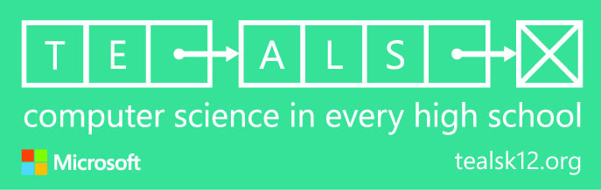

Thank You!

Slide 4
The Problem
Series of calculations that on average took 10 seconds
Users had to wait for the results
Client applications had to wait when using our API
Volume of requests were growing rapidly
Competitors could return results in less than 2 seconds

Slide 5
Ideas
Choose/build distributed computing platform
Use graphics cards
Use existing standard technology/protocols
Notes:
A – Had experience with proprietary platform - Fabric
B – Would have had to rewrite code, limited to floating point math, buy new hardware

Slide 6
Decision
Notes:
Secret sauce
- .Net with cached data
- Messaging over RabbitMQ using MassTransit
Who has used a queue before – MSMQ (Microsoft Message Queue)
RabbitMQ implements AMQP protocol

Slide 7
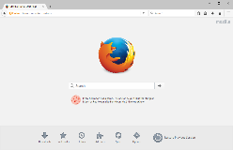


Traditional Queue (Point-to-Point)
Notes:
Example – sending an email, place a queue in front of SMTP server
- Popular on mainframes
- Less popular now that cores are cheaper and servers virtualized

Slide 8
Traditional Queue (Point-to-Point)
Notes:
Scenario – user action triggers a 100 emails
Advantages
- Can meter consumption
- Can retry on failure
- Can persist to hard drive

Slide 9




Publish-Subscribe (Pub-Sub)
Notes:
Example – someone buys something
Have to ship item
Have to charge credit card
Have to send an invoice
We use this as part of our repository – notify data updates

Slide 10
Request-Reply

Slide 11
Request-Reply

Slide 12
Why not HTTP
No need to configure a load balancer*
Auto discovery*
Application defines its capacity and availability
Faster and more efficient?
* The cloud and Kubernetes may make these easier

Slide 13
Application Call Stack
Per Iteration Time Total Time
~ logic ~ 50 ms
for(50) 200 ms 10 seconds
for(10) 1 ms 10 ms
for(250) 0 ms 100 ms
for(5) 0 ms 1 ms
~ logic ~ 99 ms
~ logic ~ 50ms
Total Duration: 10100 ms

Slide 15
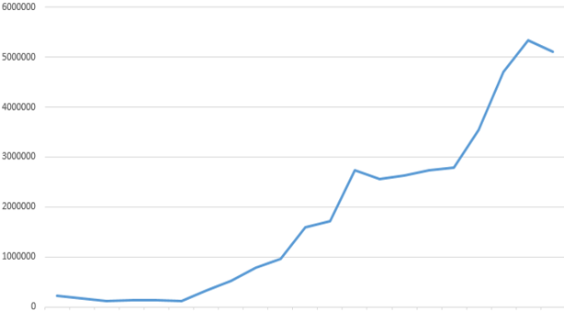
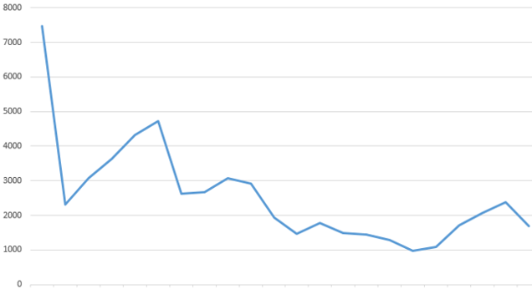
Our Story
Request Volume
API Response Time (ms)

Slide 16
Show and Tell
Notes:
.Net
- Mining for CryptoCurrency
- Serialization
- MassTransit also supports Azure Service Bus, ActiveMQ, and Amazon Simple Queue Service (SQS) and Simple Notification Service (SNS)
For RabbitMQ
- Windows vs Linux
- Memory high watermark
- Split brain issue – change cluster_partition_handling config setting to autoheal
- HA
- durability
- priority
- federation

Slide 17


Come Work With Us
Hiring a Full Stack Web Developer
Great benefits
Small but growing team
Develop software for our SasS products
C# and Angular w/ Typescript

Slide 18



@jfnkoded
linkedin.com/in/justin-fisher-dev/
github.com/nkoded/message-driven-architecture-presentation

